Slide 1
Hierarchical Clustering

Slide 2
Outline
What is hierarchical clustering
Single linkage
The other linkage schemes

Slide 3
What is hierarchical clustering
Hierarchical clustering algorithms build a hierarchy of clusters where each node is a cluster consists of the clusters of its daughter nodes.
Choosing the number of clusters (k) is difficult
Often there is no single right answer, because of multiscale structure

Slide 4
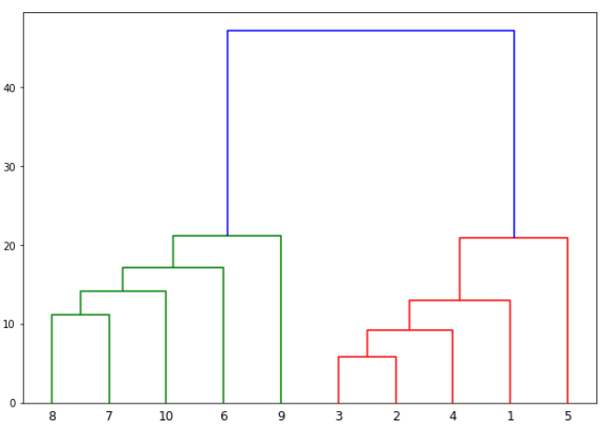
Hierarchical clustering
Divisive
Agglomerative

Slide 5
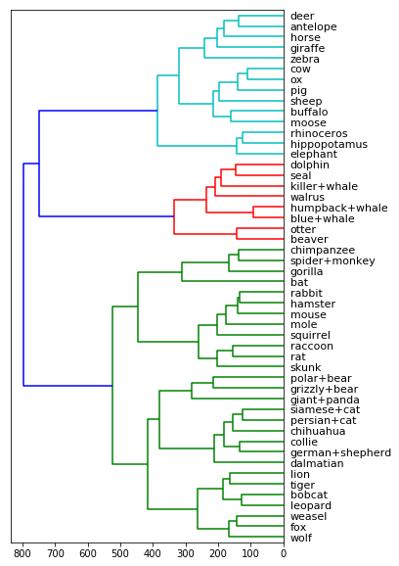
Clustering of animals based on many features

Slide 6
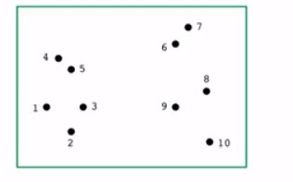
The single linkage algorithm
Start with each point in its own, singleton, cluster
Repeat until there is just one cluster Merge the two clusters with the closest pair of points

Slide 7


Linkage methods
C
C’
Start with each point in its own cluster
Repeat until there is just one cluster . Merge the two “closest” clusters
How to measure the distance between two clusters, C’,C?
Single linkage
Complete linkage
$$dist\left(C,C^{′}\right)=\min_{x∈C,x^{′}∈C^{′}}{|\left|x−x^{′}\right||}$$
$$dist\left(C,C^{′}\right)=\max_{x∈C,x^{′}∈C^{′}}{|\left|x−x^{′}\right||}$$

Slide 8
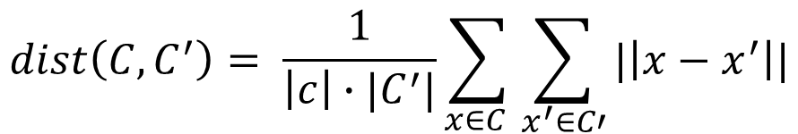
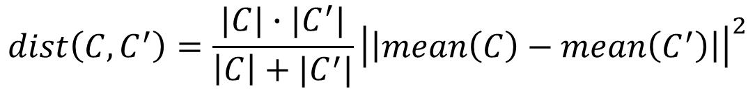
Average linkage
C
C’
Average pairwise distance between points in the two clusters
Distance between cluster center
Ward’s method: increase in k-mean cost from merging the clusters
$$dist\left(C,C^{′}\right)= \frac{1}{\left|c\right|∙|C^{′}|}\sum_{x∈C }{\sum_{x^{′}∈C′}{|\left|x−x^{′}\right||}}$$
$$dist\left(C,C^{′}\right)=|\left|mean\left(C\right)−mean\left(C^{′}\right)\right||$$
$$dist\left(C,C^{′}\right)=\frac{|C|∙|C^{′}|}{\left|C\right|+|C^{′}|}{\left|\left|mean\left(C\right)−mean\left(C^{′}\right)\right|\right|}^{2}$$

Slide 9
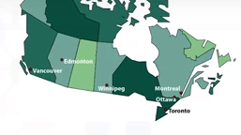
Agglomerative clustering
TO OT MO VA ED WI
j
 | TO | OT | VA | MO | WI | ED
TO |  | 351 | 3363 | 505 | 1510 | 2699
OT |  |  | 3543 | 167 | 1676 | 2840
VA |  |  |  | 3690 | 1867 | 819
MO |  |  |  |  | 1824 | 2976
WI |  |  |  |  |  | 1195
ED
i

Slide 10
Agglomerative clustering
OT OT MO VA ED WI
 | TO | OT/MO | VA | WI | ED
TO |  | 351 | 3363 | 1510 | 2699
OT/MO |  |  | 3543 | 1676 | 2840
VA |  |  |  | 1867 | 819
WI |  |  |  |  | 1195
ED
 | TO/OT/MO | VA | WI | ED
TO/OT/MO |  | 3543 | 1676 | 2840
VA |  |  | 1867 | 819
WI |  |  |  | 1195
ED

Slide 11
Hierarchical clustering
OT OT MO VA ED WI
 | TO/OT/MO | VA/ED | WI
TO/OT/MO |  | 2840 | 1676
VA/ED |  |  | 1667
WI
Dendrogram
OT OT MO VA ED WI
 | TO/OT/MO | VA/ED/WI
TO/OT/MO |  | 1676
VA/ED/WI

Slide 12
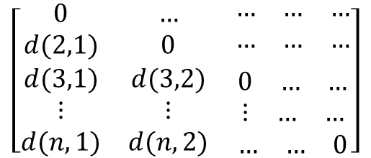
Agglomerative algorithm
Create n clusters, one for each data point
Compute the proximity matrix
Repeat i. Merge the two closest clusters ii. Update the proximity matrix
Until only a single cluster remains
How do we measure the distances between these clusters? How do we define the nearest among clusters?
$$\left[\begin{matrix}0 & … & \begin{matrix}… & … & …\end{matrix} \\ d(2,1) & 0 & \begin{matrix}… & … & …\end{matrix} \\ \begin{matrix}d(3,1) \\ ⋮ \\ d(n,1)\end{matrix} & \begin{matrix}d(3,2) \\ ⋮ \\ d(n,2)\end{matrix} & \begin{matrix}\begin{matrix}0 & … & …\end{matrix} \\ \begin{matrix}⋮ & … & …\end{matrix} \\ \begin{matrix}… & … & 0\end{matrix}\end{matrix}\end{matrix}\right]$$

Slide 13
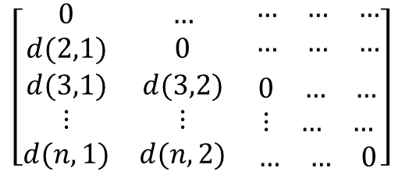
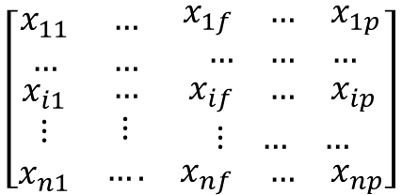
Similarity / Distance
Patient 1
Age | BMI | BP
54 | 190 | 120
Patient 1
Age | BMI | BP
50 | 200 | 125
$$Dis\left(p1,p2\right)=\sqrt{{\left(54−50\right)}^{2}+{\left(190−200\right)}^{2}+{\left(120−125\right)}^{2}}=11.87$$
dataset
Dissimilarity matrix
$$\left[\begin{matrix}x_{11} & … & \begin{matrix}x_{1f} & … & x_{1p}\end{matrix} \\ … & … & \begin{matrix}… & … & …\end{matrix} \\ \begin{matrix}x_{i1} \\ ⋮ \\ x_{n1}\end{matrix} & \begin{matrix}… \\ ⋮ \\ ….\end{matrix} & \begin{matrix}\begin{matrix}x_{if} & … & x_{ip}\end{matrix} \\ \begin{matrix}⋮ & … & …\end{matrix} \\ \begin{matrix}x_{nf} & … & x_{np}\end{matrix}\end{matrix}\end{matrix}\right]$$
$$\left[\begin{matrix}0 & … & \begin{matrix}… & … & …\end{matrix} \\ d(2,1) & 0 & \begin{matrix}… & … & …\end{matrix} \\ \begin{matrix}d(3,1) \\ ⋮ \\ d(n,1)\end{matrix} & \begin{matrix}d(3,2) \\ ⋮ \\ d(n,2)\end{matrix} & \begin{matrix}\begin{matrix}0 & … & …\end{matrix} \\ \begin{matrix}⋮ & … & …\end{matrix} \\ \begin{matrix}… & … & 0\end{matrix}\end{matrix}\end{matrix}\right]$$
?

Slide 14
Distance Between clusters
Single-Linkage clustering Minimum distance between clusters
Complete-Linkage clustering Maximum distance between clusters
Average linkage clustering Average distance between clusters
Centroid linkage clustering Distance between cluster centroids.

Slide 15
Advantages Vs. Disadvantages
Advantages | Disadvantages
Doesn’t required number of clustering to be specified | Can never undo any previous steps throughout the algorithm
Easy to implement | Generally has long runtimes
Produce a dendrogram, which helps with understanding the data | Sometimes difficult to identify the number of clustering by the dendrogram

Slide 16
Hierarchical clustering Vs K-means
K-means | Hierarchical clustering
Much more efficient | Can be slow for large datasets
Requires the number of clusters to be specified | Does not require the number of clusters to run
Gives only one partitioning of the data based on the predefined number of clusters | Give more than one partitioning depending on the resolution
Potentially returns different clusters each time it is run due to random initialization of centroid | Always generates the same clusters

